Slide 1
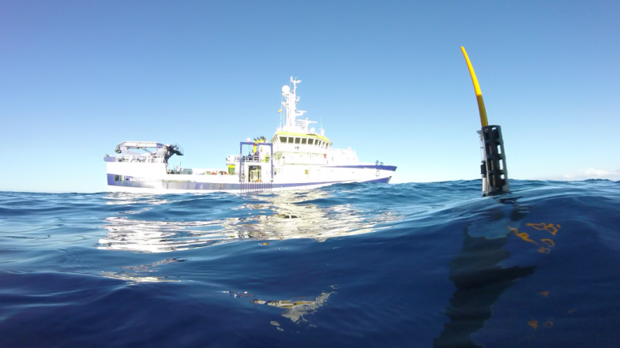
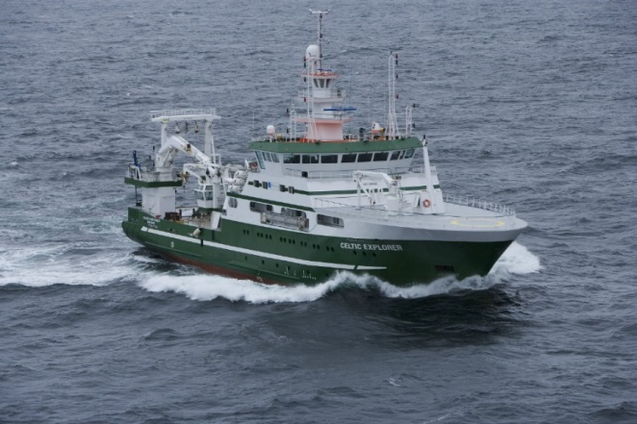
Next Generation European Research Vessels:
Current Status and Foreseeable Evolution
Per W. Nieuwejaar, Institute of Marine Research (IMR), EMB Working Group Chair
RV Ángeles Alvariño and Argo float
RV Celtic Explorer © Marine Institute
Research Vessels in the European Ocean Observation landscape
12th June 2019
ERVO 2019, Hamburg, Germany

Slide 2
EMB Working Group on Research Vessels
European Marine Board (EMB) in collaboration with European Research Vessel Operators (ERVO)
Kicked off May 2018, Position Paper 25 due Autumn 2019
Main Objectives:
Review the current status of European Research Vessels and related equipment;
Identify the progress made since the previous EMB Position Paper 10 in 2007;
Assess the role of Research Vessels as part of the wider European Ocean Observing System (EOOS) and within the scope of advancing marine and ocean science research;
Explore options for future management of the fleet within Europe, exploring wider-ranging collaborations, co-ownership, chartering, training at sea opportunities etc.;
Explore options for enhancing the European Research Vessel Fleet capability as a world-class infrastructure resource for the international marine research community and finding ways to further enhance existing collaboration between projects, networks and nations to enhance access, training and interoperability opportunities, and hence cost-efficient use of these valuable resources.
Notes:
The working group kicked off in May 2018 and has met 3 times
The main output will be a position paper which is currently in the review phase and which is expected in Autumn 2019

Slide 3
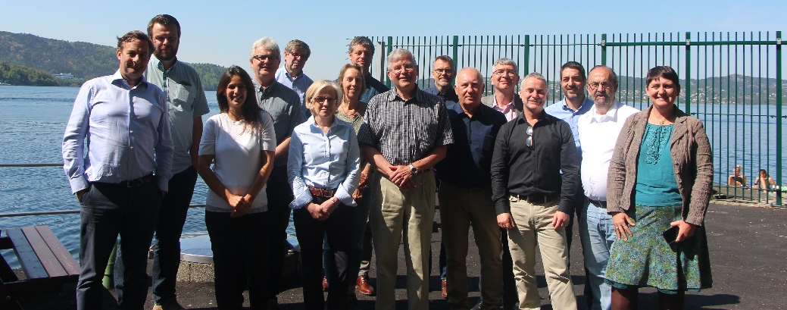
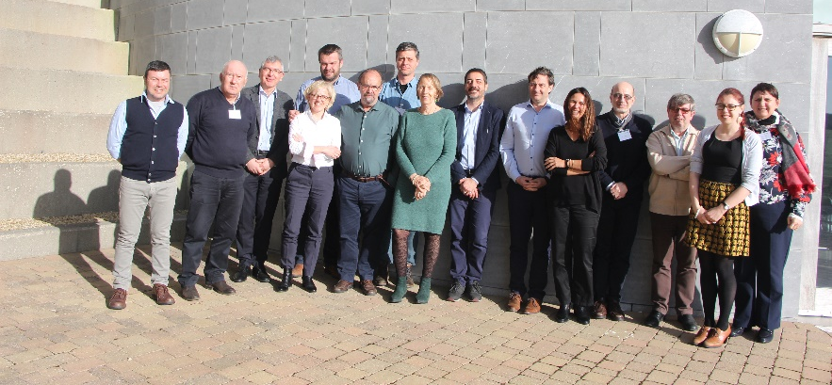
Working Group Members
Chair - Per Nieuwejaar, Institute of Marine Research (IMR), Norway
Co-chair - Valérie Mazauric, Ifremer, France
Mafalda Carapuço, Instituto Português do Mar e da Atmosfera (IPMA), Portugal
André Cattrijsse, Flanders Marine Institute (VLIZ), Belgium
Franco Coren, Instituto Nazionale di Oceanografia e di Geofisica Sperimentale (OGS), Italy
Juanjo Danobeitia, European Multidisciplinary Seafloor and Water-Column Observatory (EMSO), Italy
Colin Day, National Oceanographic Centre (NOC), UK
Aodhan Fitzgerald, Marine Institute (MI), Ireland
Stefan Florescu, GeoEcoMar, Romania
Jose Ignacio Diaz, Spanish Institute of Oceanography (IEO), Spain
Michael Klages, Alfred Wegener Institute (AWI), Germany
Erica Koning, Netherlands Institute for the Sea (NIOZ-NMF), Netherlands
Olivier Lefort, Ifremer, France
Giuseppe Magnifico, Italian National Research Council (CNR), Italy
Øystein Mikelborg, Norwegian Polar Institute (NPI), Norway
Lieven Naudts, Royal Belgian Institute of Natural Sciences (RBINS - OD Nature), Belgium
Christian Betzler, University of Hamburg, Germany
Notes:
The working group is made up of 16 members from 11 European countries, proposed by the EMB members

Slide 4
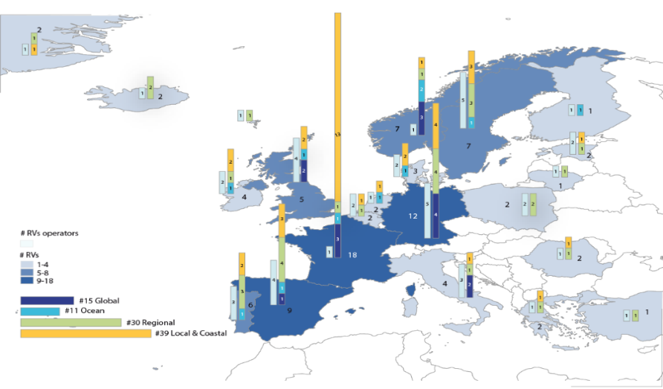
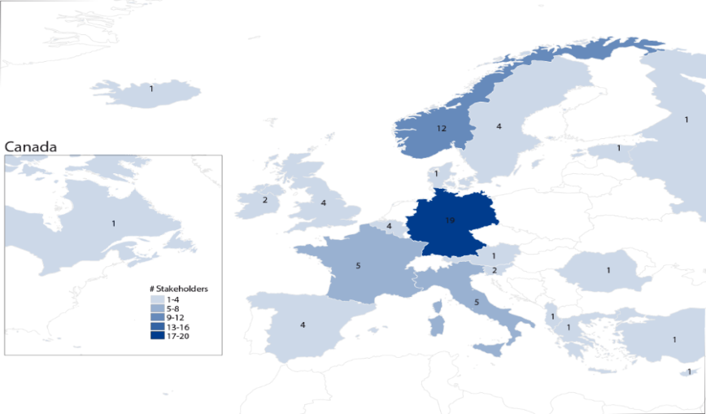
Consulting with Stakeholders
Survey sent to research vessel operators in Summer 2018
45 responses covering 104 vessels from 22 countries
Collected information on the national management of the European research vessel fleets, including funding mechanisms, investment plans, collaborations and partnerships, and training opportunities
Survey sent to research vessel stakeholders in Summer 2018
Over 70 responses from 23 countries
Collected information regarding Research Vessels and their use in Europe, and the perspectives of different stakeholder groups including research institutions, funding agencies, industry and technology developers
The working group and its activities have also been presented and discussed at a number of conferences, meetings and events
Notes:
Two surveys were sent out to stakeholders, and their input included in what is written in the position paper. We thank everyone who responded!
The work has also been discussed widely with relevant communities as an opportunity to hear their ideas and inputs, including:
6th ENVRI week – Marine Domain, 14-18 May 2018, Netherlands
ERVO meeting, 12-14 June 2018, Valletta, Malta
IRSO 2018, 4 October 2018, Barcelona, Spain
EurOcean open event “Marine Research and Knowledge in support of Policy Making and Society: Deep-sea Research as a Case Study”, 15 October 2018, Azores, Portugal
EOOS Conference 2018, 21-23 November 2018, Brussels, Belgium
7th ENVRI week – Marine Domain, 15 February 2018, Riga, Latvia
Round table discussion at 3rd Conference of Italian Marine Geologists, Marine geology in Italy, 21-22 February 2019, Rome, Italy
EUROFLEETS+ Project kick-off meeting, 5-7 March 2019, Galway, Ireland
EurOCEAN 2019 Conference, 11-12 June 2019, Paris, France
ERVO Meeting, 12-14 June 2019, Hamburg, Germany

Slide 5
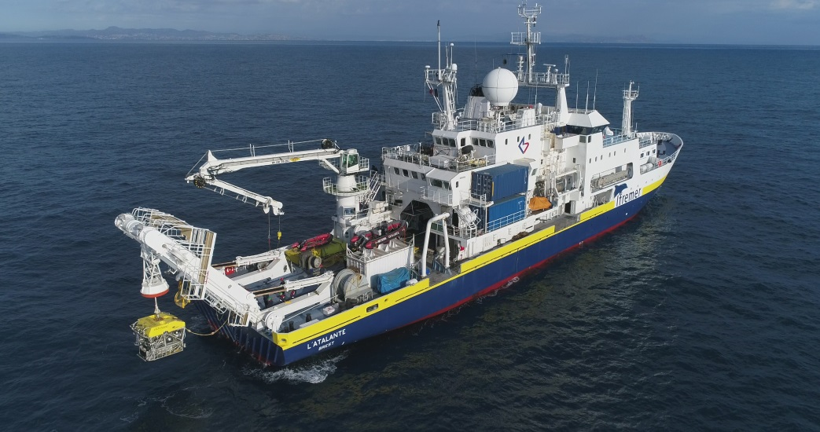
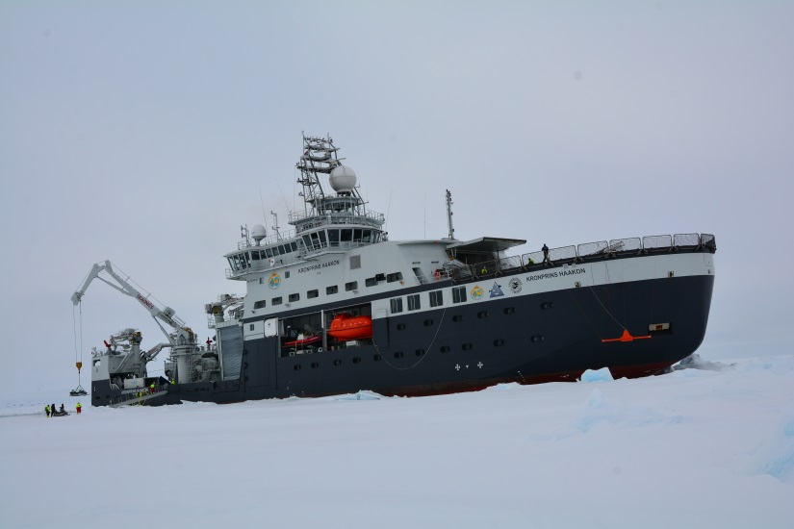
Position Paper Content
The position paper includes the following main chapters:
Research vessels as a platform and interface for ocean technology
Deep sea
Polar regions
Towards an end-to-end European Ocean Observing System (EOOS): A research vessel perspective
Training the next generation of professionals
Management processes in the countries and partnerships developed in Europe
RV L’Atalante and ROV Victor 6000 © Ifremer, S. Lesbats
RV Kronprins Haakon © Norwegian Polar Institute, Ø. Mikelborg

Slide 6
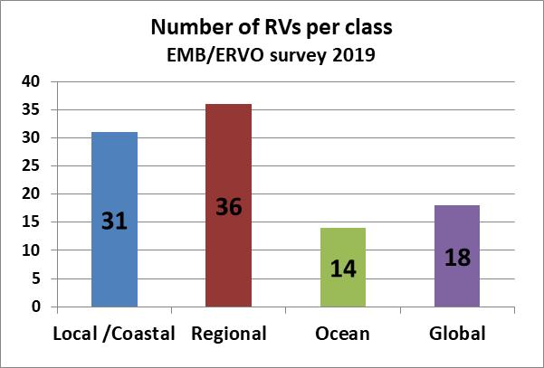
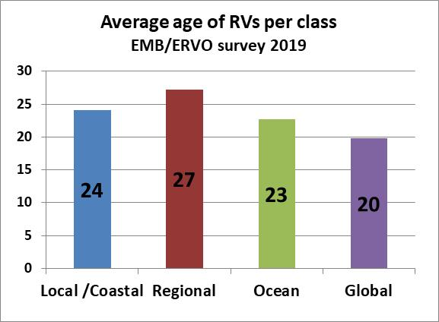
Main Messages (1)
Europe currently has 99 research vessels from 23 countries that are:
Openly available for public research
Able to operate at least on a regional scale
Equipped with a minimum set of basic
capabilities to conduct standard research
Europe currently has a highly capable, but aging Research Vessel fleet, with a current average age of 24 years
The capabilities of the fleet have increased dramatically since 2007, especially in terms of the equipment and Large EXchangeable Instruments (LEXI), and in keeping up with new technological developments

Slide 7
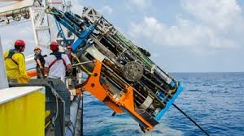
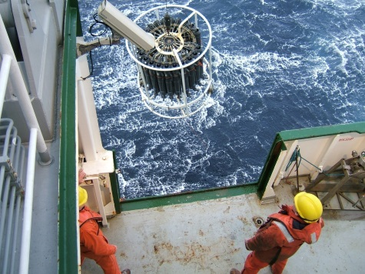
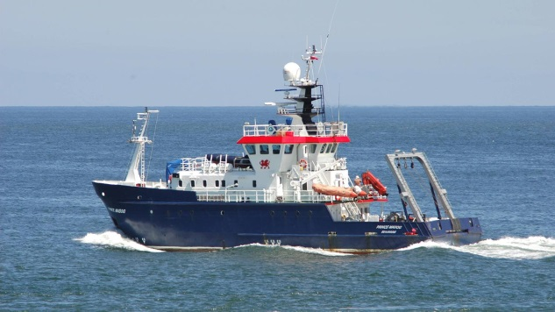
Main Messages (2)
The European Research Vessel fleet comprises:
19 deep sea capable RVs, but only 7 with acoustics capabilities, winches and A-frames capable to operate at 6000 m water depth, deploy large equipment, and with at least 30 berths for scientists and technicians
19 ice-strengthened RVs, but only 5 ice-going/ice-breaking RVs capable of year-round operations under various ice conditions
Research Vessels are essential in Ocean Observation and have a dual role by providing the facility services for in-situ data collection and by deploying or servicing many types of EOOS components (autonomous, stationary and mobile platforms).
A close communication between EOOS and the research vessel operator community is needed to make sure that Research Vessels are fit for purpose.
CTD deployment off RV Celtic Explorer
RV Prince Madog © Bangor University
MeBo during deployment

Slide 8
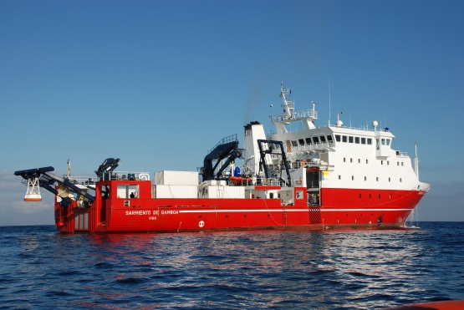
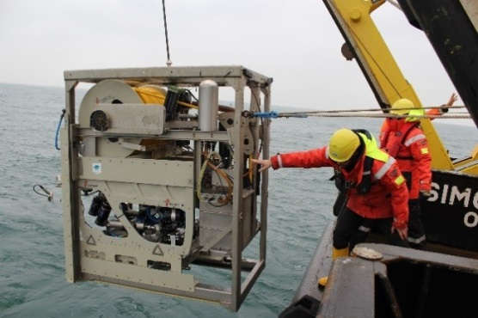
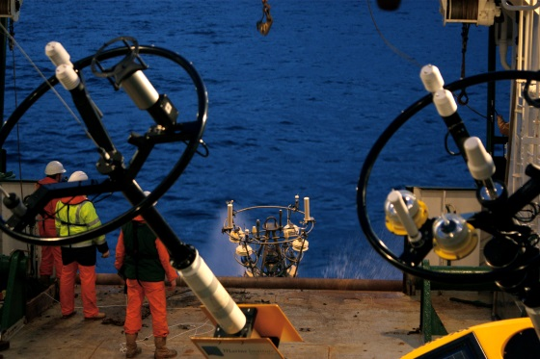
Main Messages (3)
There is a huge diversity across Europe in terms of:
Capabilities and equipment
Management structures and processes
Training possibilities (vessel crew, instruments technicians and land-based staff)
Approaches for granting and funding vessel access and ship-time
It is not possible or appropriate to highlight one “correct” approach, but options do exist for improving efficiency and collaboration in several aspects of research vessel use and management such as:
Pooling and sharing of equipment
Exploring possibilities in training and pooling of crew
Projects and/or initiatives for increasing ship access for all researchers
RV Sarmiento de Gamboa dropping ROV
ROV Genesis deployed from RV Simon Stevin © VLIZ
Weather buoy deployment off RV Celtic Explorer

Slide 9
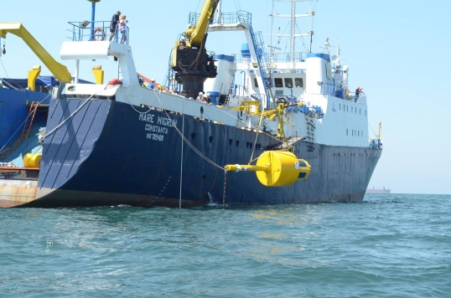
Main Recommendations (1)
Ensure periodic collection and updating of information (to be made publicly available) to keep funding agencies and decision makers informed about status and trends on:
European research vessel fleet
Research vessel fleet capabilities
Available Large EXchangeable Instruments (LEXI) and other equipment
Vessel operation and management trends
e.g using the EurOcean Research Infrastructure Database (RID), www.rid.eurocean.org
The European RV fleet is ageing and should continue to be modernized and renewed to ensure it can still support science needs of today and in the foreseeable future in terms of both quantity and capabilities.
RV Belgica II © Rolls Royce Marine, Freire Shipyard, RBINS OD Nature
RV Mare Nigrum © GeoEcoMar, Stefan Florescu
Notes:
Recommendations for different topics are also specifically presented in more detail in the position paper

Slide 10
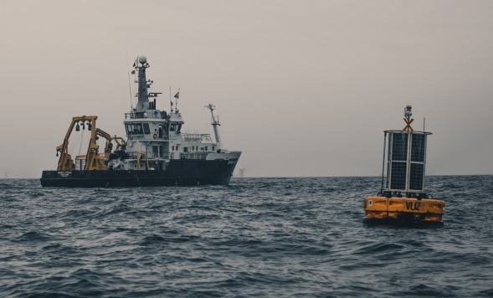
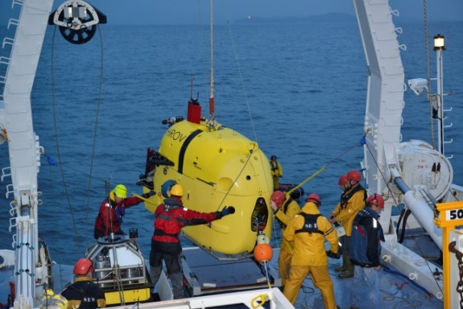
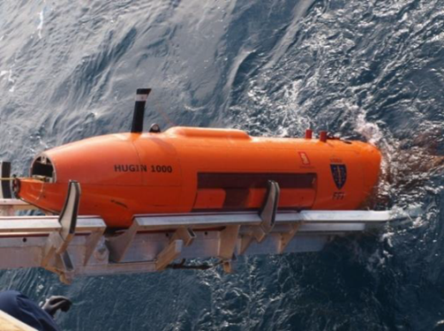
Main Recommendations (2)
The research vessel community should look towards future requirements, including being able to support the next big technological and digital developments such as:
Demand for near real-time data delivery
SMART sensors
Increasing autonomy and interaction of autonomous equipment
The essence of Research Vessels in the EOOS should be consolidated through the establishment of a prominent role of the RV operator networks in the EOOS management.
RV Simon Stevin and ICOS buoy
HROV Ariane deployed from RV Suroît © Ifremer, O. Dugornay
Retrieving of 6000m Hugin AUV on RV G.O. Sars © IMR
Notes:
Recommendations for different topics are also specifically presented in more detail in the position paper

Slide 11
Main Recommendations (3)
The research vessel community should continue on its path towards greater collaboration in order to aim for:
More effective and efficient use of resources and equipment: cooperation already exists for Global and Ocean Class vessels, but collaboration on a regional level is limited
Sharing resources on a national level, by creating national pools of equipment, instruments and maritime crew
Appropriate training for all parties involved in research vessel activities
ERVO should take an active role in promoting activities for training of instrument technicians, crew and shore-base staff, and should seek partnerships (IOC, OTGA) to develop courses on all aspects of vessel operations.
Transnational Access (TA) mechanisms based on excellent science should be further developed to give access to European Research Vessels and enlarge the community of users, in particular for deep-sea and polar Research Vessels which exist in a limited number.
Notes:
Recommendations for different topics are also specifically presented in more detail in the position paper

Slide 12
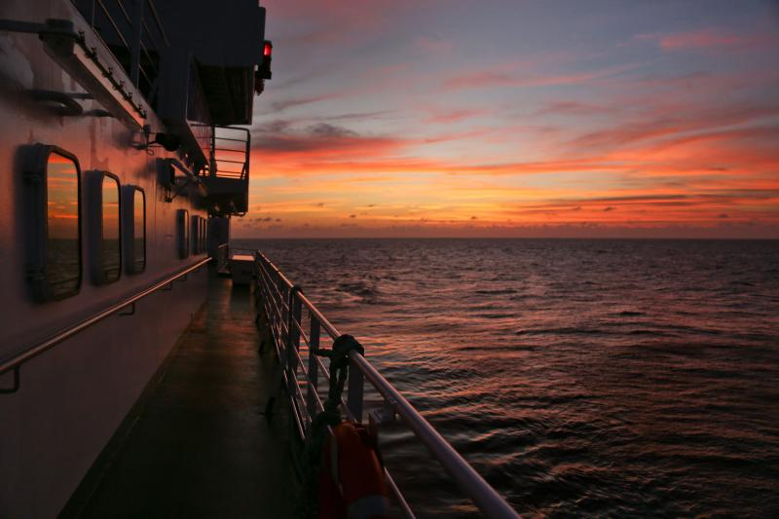
More information available online:
http://www.marineboard.eu/european-research-vessels
Credit: Kerstin Nightingale, GEOMAR. RV Meteor

Slide 13
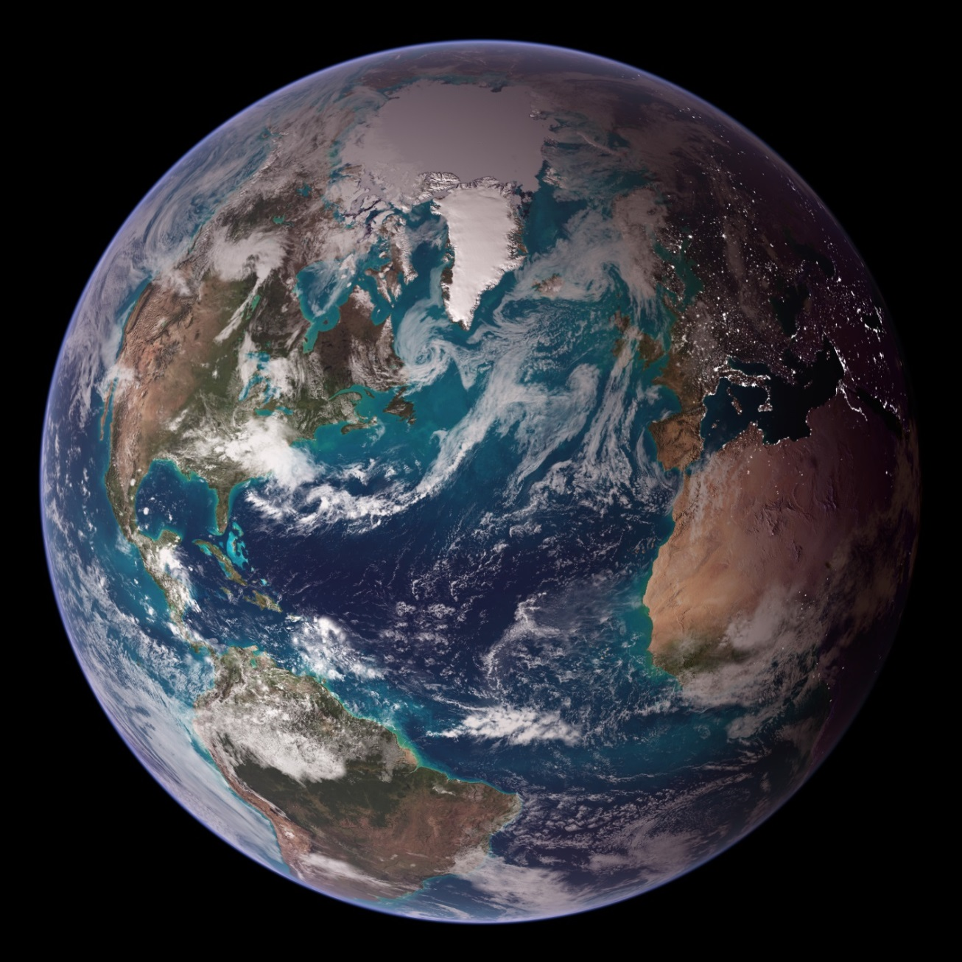
Thank you
www.marineboard.eu | www.ervo-group.eu

